Slide 1

Acknowledgement of Country
I would like to acknowledge the Bedegal people as the Traditional Custodians of this land. I would also like to pay my respects to the Elders, past and present, and extend that respect to other Aboriginal and Torres Strait Islanders who are present here today.
Notes:
Aboriginal and Torres Strait Islander people have made and are continuing to make extraordinary contributions to the scientific community and I think it likely that the future of sustainability and biodiversity here will depend on enabling and enacting Indigenous-driven solutions.

Slide 2
SCIF2001 – Workshop 4
Scientific Computation

Slide 3
Today’s Plan
Introduction to Scientific Computing using Python / R
Installing / using an Integrated Development Environment (IDE)
Some useful capabilities;
  Reading / Writing Files
  Plotting Data
  Performing Statistical Analysis
AI in coding
Further learning

Slide 4

Will you learn python/R today?
Not really!
You’ll learn a small piece.

Slide 5

But tom I already know python/R
Yay!
You could stick around to help your peers!
Or just do your own work.

Slide 6
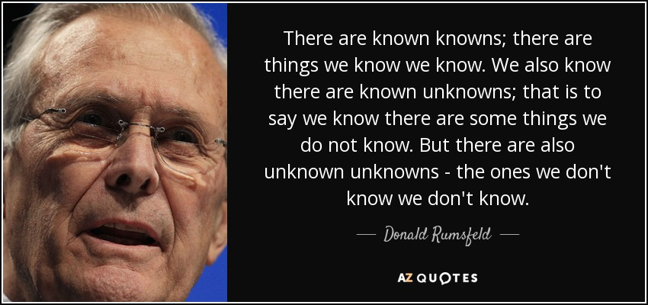
My Philosophy on teaching programming
By today, I don’t want you to know how to do things.
But I do want you to know that certain things can be done, and how to look them up!

Slide 7
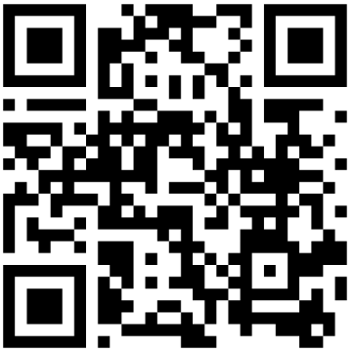

On AI and Coding
Tom’s Software Engineer Friends say it’s useful for:
Accurate boilerplate
Explaining code
Debug suggestions
Error message explanations
I (Tom) am an AI-Hater
  Never used an LLM or generative AI for any productive work.
I don’t have any advice on how to use AI to help you.
One of my favourite videos
“I think the key thing is that it can ultimately make you faster, but not better.”

Slide 8
Python and r

Slide 9
Python and R are both computing languages adept at doing calculations on data and making nice figures.
They have a lot of packages to do very cool things with data – but we’ll not learn them!
They’re also good at doing simulations.
If what you’re doing is too complicated for Excel, then you should use a scientific programming language.

Slide 10
Python or R?
There’s a lot of overlap in the capabilities of Python and R. You can do nearly everything in both. Questions to consider:
What does my supervisor/group use?
Do I have niche interests or just want to do ‘normal’ things?
Do I want to get a job outside academia?

Slide 11
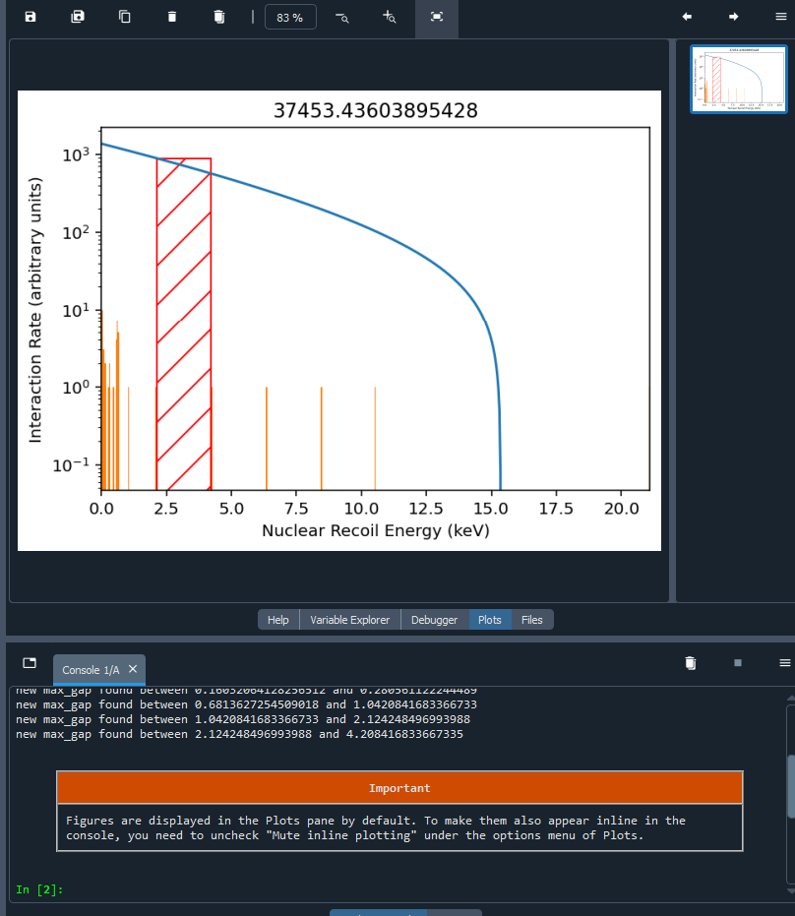
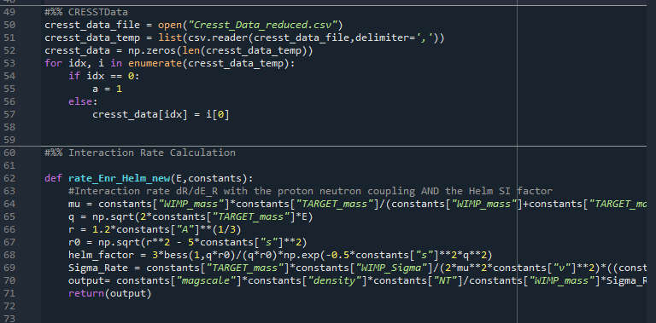
Scripting vs ‘Visual’ progrmaming
In python and R, you’re writing a series of instructions that you then execute. Things are only displayed if you tell them to be displayed.

Slide 12
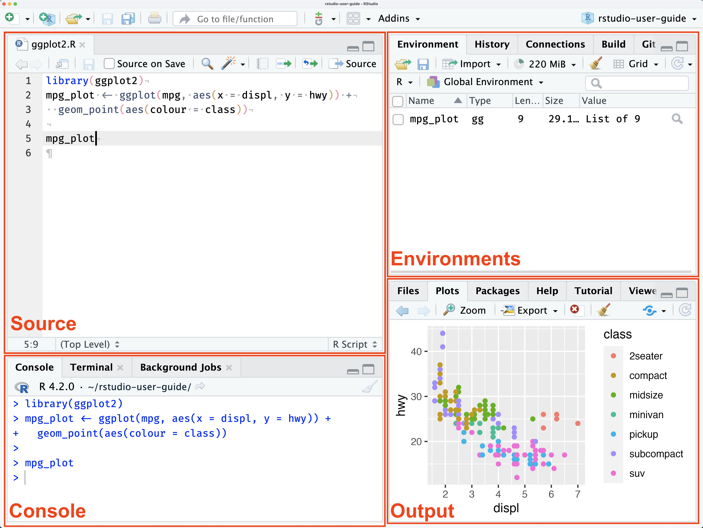

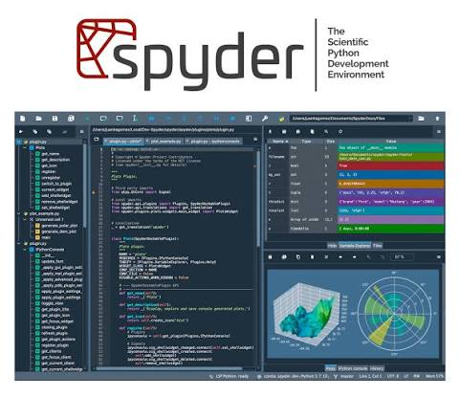
Integrated Development Environment
For R, the most popular IDE is called R studio
Something that lets you:
Write Code
Run Code
Look at the outputs of Code
(Look at all the variables even if you didn’t ask!)
Is called an Integrated Development Environment, or IDE.
For Python, I like Spyder:

Slide 13
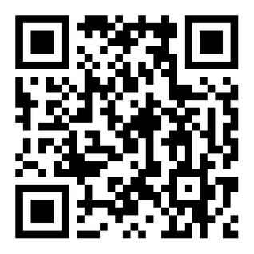
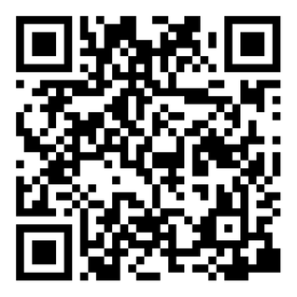
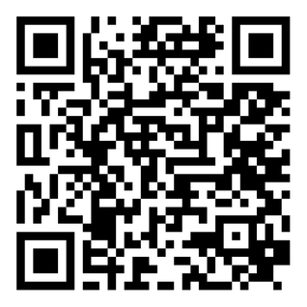
Activity 1: Install an IDE
For R-Studio
For Python
Download R (the language)
Download Anaconda and then open Spyder
Download RStudio

Slide 14
Some useful capabilities
Pick one (or more) of the following and try to get it! I’ll be floating around to help.

Slide 15
How to learn
From here, the best way to learn is to:
Identify the action you want to undertake (be as specific as possible).
Google “action in Python/R” OR ask an LLM how to “action in Python/R”
Read and (try to) understand the action.
Repeat until you can do the thing you want to do.

Slide 16
Read/Write a file
Actions:
Read a CSV in Python/R
Add all values together.
I’ve put a stupidly long CSV on the moodle. What is the sum of all the values?
Actions:
Read a CSV in Python/R
Go through the values and multiply each by 3.
Write a CSV in Python/R
Output the CSV where every number is multiplied by 3

Slide 17
Plot data
Actions:
Read a CSV in Python/R
Plot a histogram of data.
With the stupidly long CSV, generate a histogram.
Actions:
Read a CSV in Python/R
Plot a histogram of data.
Customise a histogram.
Plot two items on the same graph.
Plot two histograms on top of each other; one with 100 times the bins!

Slide 18
Statistical Analysis
Actions:
Read a CSV in Python/R
Calculate mean of data.
Calculate standard deviation of data.
With the stupidly long CSV, generate the summary statistics (mean, standard deviation)
Actions:
Read a CSV in Python/R
Split a dataset in two.
Perform a P test of each.
Split the stupidly long CSV in half and compare the halves with a p-test!

